Slide 1
Beginner’s
competitive programming
Alex, Geoffrey, Cherry

Slide 2
About us
Alex: Instructor, Material
Geoffrey: Instructor, Infrastructure (SOON)
Cherry: Evaluation, Material Testing

Slide 3
Purpose?
-Coding!
-Problem Solving!

Slide 4
First line of code
Hello, World!

Slide 5
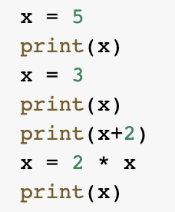
Variables
Variables store data that can be changed
It can store words as well!

Slide 6
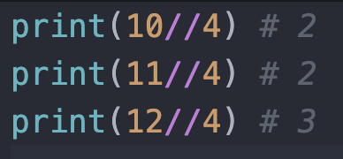
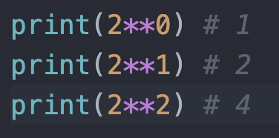
Basic Arithmetic
Integer Division
Power
Rounding Up and Rounding Down

Slide 7
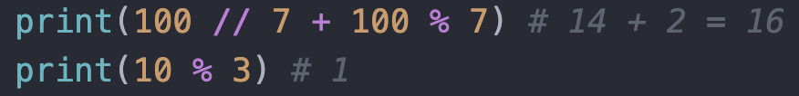
Modulo
Remainders!

Slide 8
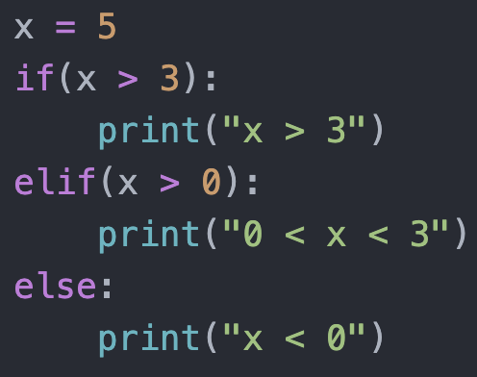
Condition

Slide 9

Good Coding Habit Number one
Comments:
Be precise and clear!

